Slide 1
CS 61C: Great Ideas in Computer Architecture (Machine Structures) Caches Part 3
Instructors:
John Wawrzynek & Vladimir Stojanovic
http://inst.eecs.berkeley.edu/~cs61c/

Slide 2


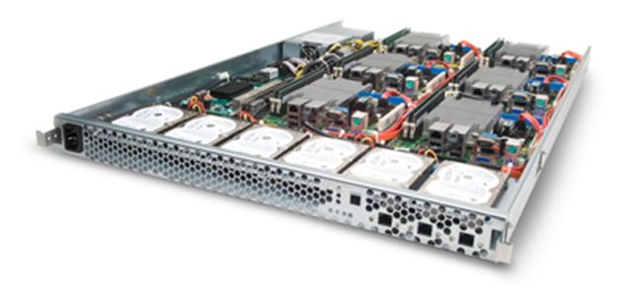
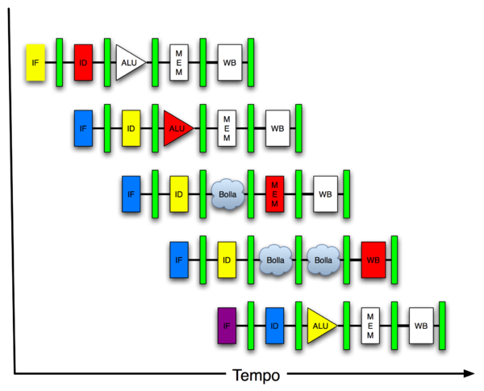
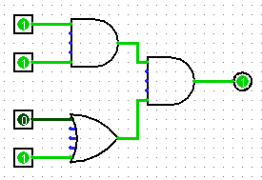
You Are Here!
Software Hardware
Parallel Requests
Assigned to computer
e.g., Search “Katz”
Parallel Threads
Assigned to core
e.g., Lookup, Ads
Parallel Instructions
>1 instruction @ one time
e.g., 5 pipelined instructions
Parallel Data
>1 data item @ one time
e.g., Add of 4 pairs of words
Hardware descriptions
All gates @ one time
Programming Languages
Warehouse Scale Computer
Smart Phone
Harness Parallelism &
Achieve High Performance
Computer
Today’s
Lecture
Core
…
Core
Memory (Cache)
Input/Output
Core
Instruction Unit(s)
Functional
Unit(s)
A₀+B₀
A₁+B₁
A₂+B₂
A₃+B₃
Main Memory
Logic Gates

Slide 3
Review from Last Lecture
Cache Organization
Cache Capacity
Cache Addressing
Cache write policies
AMAT (average memory access time)

Slide 4
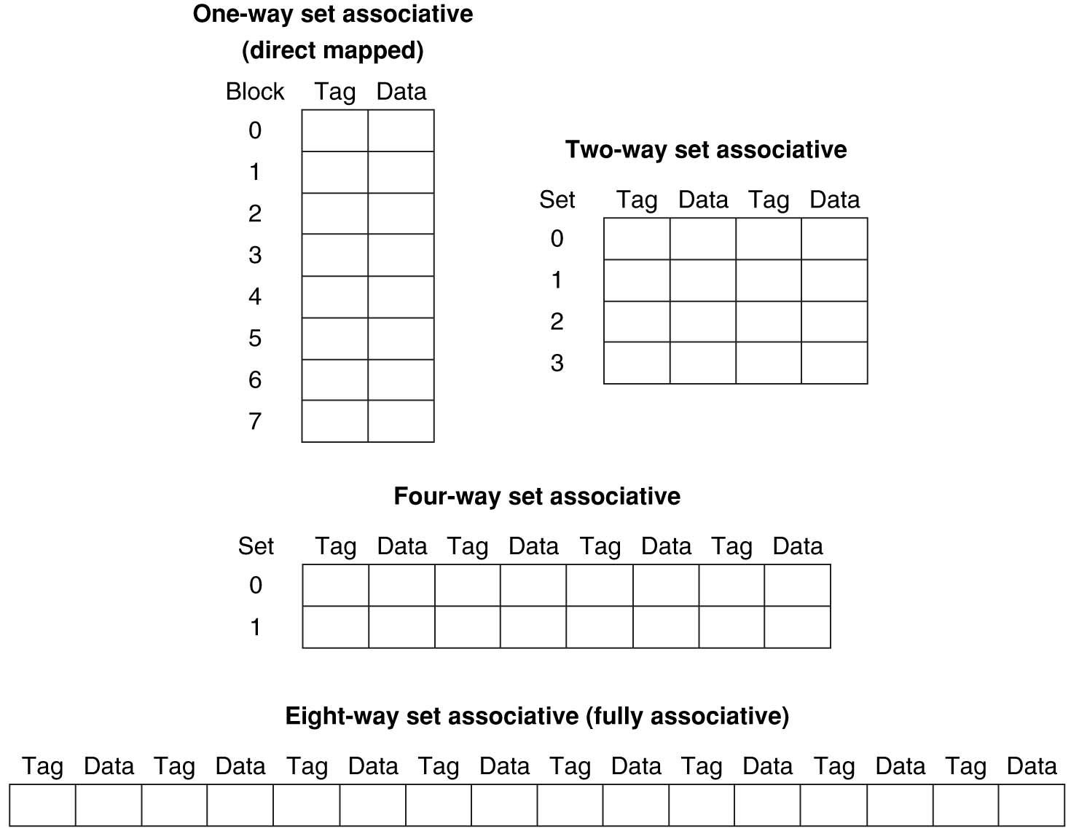
Different Organizations of an Eight-Block Cache
Total size of $ in blocks is equal to number of sets × associativity. For fixed $ size and fixed block size, increasing associativity decreases number of sets while increasing number of elements per set. With eight blocks, an 8-way set-associative $ is same as a fully associative $.

Slide 5
Total Cache Capacity =
Associativity × # of sets × block_size
Bytes = blocks/set × sets × Bytes/block
C = N × S × B
Tag
Index
Byte Offset
address_size = tag_size + index_size + offset_size
= tag_size + log₂(S) + log₂(B)

Slide 6
Write Policy Choices
Cache hit:
write through: writes both cache & memory on every access
Generally higher memory traffic but simpler pipeline & cache design
write back: writes cache only, memory `written only when dirty entry evicted
A dirty bit per line reduces write-back traffic
Must handle 0, 1, or 2 accesses to memory for each load/store
Cache miss:
no write allocate: only write to main memory
write allocate (aka fetch on write): fetch into cache
Common combinations:
write through and no write allocate
write back with write allocate

Slide 7
Average Memory Access Time (AMAT)
Average Memory Access Time (AMAT) is the average time to access memory considering both hits and misses in the cache
AMAT = Time for a hit + Miss rate × Miss penalty
Notes:
AMAT = 1 + 0.02x50 = 2

Slide 8
Today
Cache Replacement Policies
Understanding Cache misses
Increasing Cache Performance
Performance of multi-level Caches (L1,L2, …)
Real world example caches

Slide 9
Four-Way Set-Associative Cache
2⁸ = 256 sets each with four ways (each with one block)
31 30 . . . 13 12 11 . . . 2 1 0
Byte offset
Tag
22
8
Index
Index
V
Tag
Data
V
Tag
Data
V
Tag
Data
V
Tag
Data
0
1
2
.
.
.
253
254
255
0
1
2
.
.
.
253
254
255
0
1
2
.
.
.
253
254
255
0
1
2
.
.
.
253
254
255
Way 0
Way 1
Way 2
Way 3
32
4x1 select
Hit
Data
Notes:
This is called a 4-way set associative cache because there are four cache entries for each cache index. Essentially, you have four direct mapped cache working in parallel.
This is how it works: the cache index selects a set from the cache. The four tags in the set are compared in parallel with the upper bits of the memory address.
If no tags match the incoming address tag, we have a cache miss.
Otherwise, we have a cache hit and we will select the data from the way where the tag matches occur.
This is simple enough. What is its disadvantages?
+1 = 36 min. (Y:16)

Slide 10
Costs of Set-Associative Caches
N-way set-associative cache costs
N comparators (delay and area)
MUX delay (set selection) before data is available
Data available after set selection (and Hit/Miss decision). DM $: block is available before the Hit/Miss decision
In Set-Associative, not possible to just assume a hit and continue and recover later if it was a miss
When miss occurs, which way’s block selected for replacement?
Least Recently Used (LRU): one that has been unused the longest (principle of temporal locality)
Must track when each way’s block was used relative to other blocks in the set
For 2-way SA $, one bit per set → set to 1 when a block is referenced; reset the other way’s bit (i.e., “last used”)
Notes:
First of all, a N-way set associative cache will need N comparators instead of just one comparator (use the right side of the diagram for direct mapped cache).
A N-way set associative cache will also be slower than a direct mapped cache because of this extra multiplexer delay.
Finally, for a N-way set associative cache, the data will be available AFTER the hit/miss signal becomes valid because the hit/mis is needed to control the data MUX.
For a direct mapped cache, that is everything before the MUX on the right or left side, the cache block will be available BEFORE the hit/miss signal (AND gate output) because the data does not have to go through the comparator.
This can be an important consideration because the processor can now go ahead and use the data without knowing if it is a Hit or Miss. Just assume it is a hit.
Since cache hit rate is in the upper 90% range, you will be ahead of the game 90% of the time and for those 10% of the time that you are wrong, just make sure you can recover.
You cannot play this speculation game with a N-way set-associative cache because as I said earlier, the data will not be available to you until the hit/miss signal is valid.
+2 = 38 min. (Y:18)

Slide 11
Cache Replacement Policies
Random Replacement
Hardware randomly selects a cache evict
Least-Recently Used
Hardware keeps track of access history
Replace the entry that has not been used for the longest time
For 2-way set-associative cache, need one bit for LRU replacement
Example of a Simple “Pseudo” LRU Implementation
Assume 64 Fully Associative entries
Hardware replacement pointer points to one cache entry
Whenever access is made to the entry the pointer points to:
Move the pointer to the next entry
Otherwise: do not move the pointer
(example of “not-most-recently used” replacement policy)
Entry 0
Entry 1
Replacement
:
Pointer
Entry 63

Slide 12
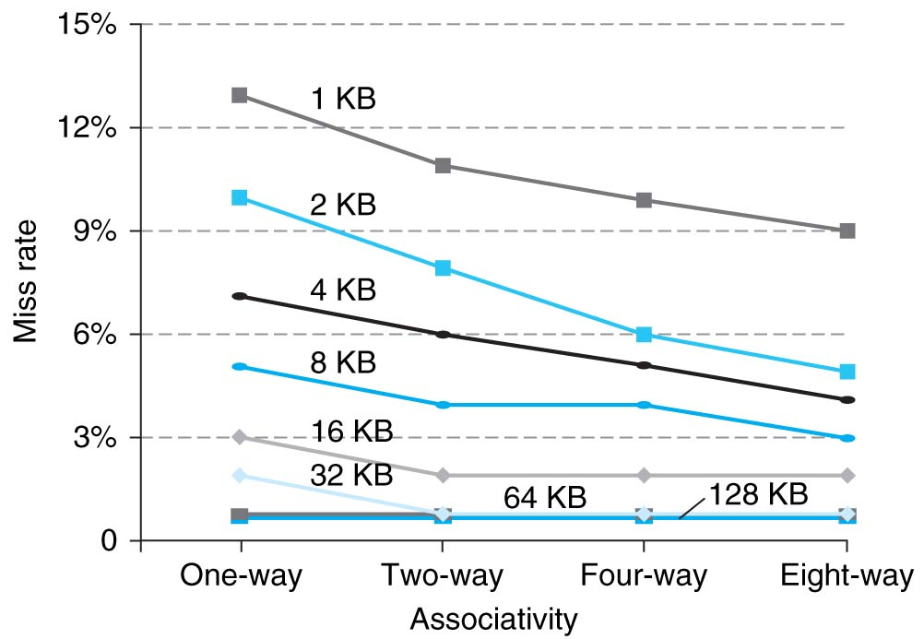
Benefits of Set-Associative Caches
Largest gains are in going from direct mapped to 2-way (20%+ reduction in miss rate)
Notes:
As cache sizes grow, the relative improvement from associativity increases only slightly; since the overall miss rate of a larger cache is lower, the opportunity for improving the miss rate decreases and the absolute improvement in miss rate from associativity shrinks significantly.

Slide 13
Sources of Cache Misses (3 C’s)
Compulsory (cold start, first reference):
1st access to a block, not a lot you can do about it.
If running billions of instructions, compulsory misses are insignificant
Capacity:
Cache cannot contain all blocks accessed by the program
Misses that would not occur with infinite cache
Conflict (collision):
Multiple memory locations mapped to same cache set
Misses that would not occur with ideal fully associative cache
Notes:
(Capacity miss) That is the cache misses are due to the fact that the cache is simply not large enough to contain all the blocks that are accessed by the program.
The solution to reduce the Capacity miss rate is simple: increase the cache size.
Here is a summary of other types of cache miss we talked about.
First is the Compulsory misses. These are the misses that we cannot avoid. They are caused when we first start the program.
Then we talked about the conflict misses. They are the misses that caused by multiple memory locations being mapped to the same cache location.
There are two solutions to reduce conflict misses. The first one is, once again, increase the cache size. The second one is to increase the associativity.
For example, say using a 2-way set associative cache instead of directed mapped cache.
But keep in mind that cache miss rate is only one part of the equation. You also have to worry about cache access time and miss penalty. Do NOT optimize miss rate alone.
Finally, there is another source of cache miss we will not cover today. Those are referred to as invalidation misses caused by another process, such as IO , update the main memory so you have to flush the cache to avoid inconsistency between memory and cache.
+2 = 43 min. (Y:23)

Slide 14
How to Calculate 3C’s using Cache Simulator
Compulsory: set cache size to infinity and fully associative, and count number of misses
Capacity: Change cache size from infinity, usually in powers of 2, and count misses for each reduction in size
16 MB, 8 MB, 4 MB, … 128 KB, 64 KB, 16 KB
Conflict: Change from fully associative to n-way set associative while counting misses
Fully associative, 16-way, 8-way, 4-way, 2-way, 1-way

Slide 15
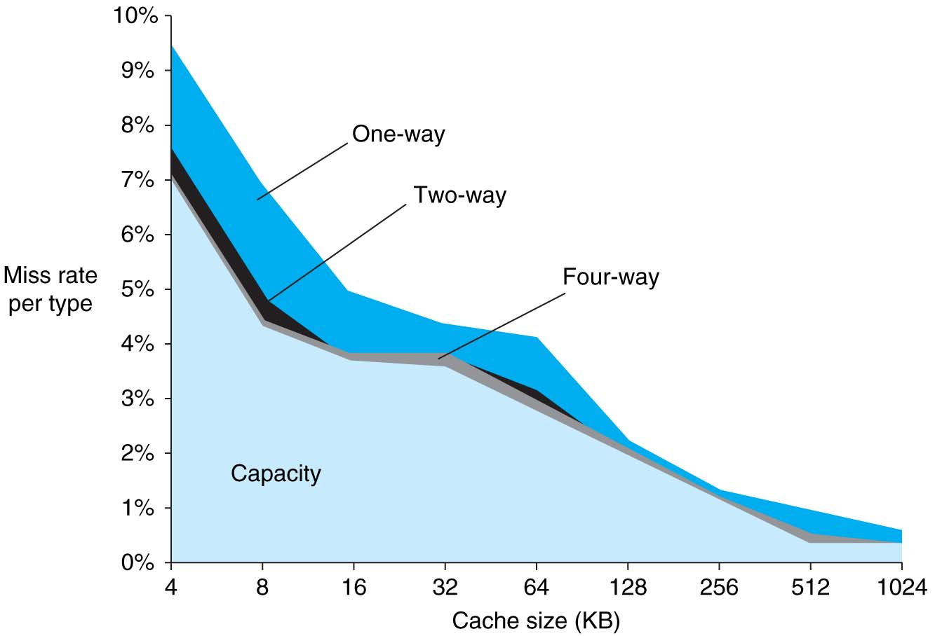
3Cs Analysis
Three sources of misses (SPEC2000 integer and floating-point benchmarks)
Compulsory misses 0.006%; not visible
Capacity misses, function of cache size
Conflict portion depends on associativity and cache size

Slide 16
Administrivia
Project 3-2, delayed. Posted Sunday 10/25 now due 11/1.
Lab 7 will help you with the CPU project (do it before the project).
No Midterm I regrade requests after 10/25 (Sunday).

Slide 17
CPU-Cache Interaction (5-stage pipeline)
0x4
Add
E
Decode,
Register
Fetch
M
A
we
Y
addr
bubble
ALU
Y
IR
B
Primary
Data
Cache
rdata
PC
addr
inst
D
R
hit?
wdata
hit?
wdata
PCen
Primary
Instruction
Cache
MD1
MD2
Stall entire CPU on data cache miss
To Memory Control
Cache Refill Data from Lower Levels of Memory Hierarchy
Notes:
How are writes to istream handled?

Slide 18
Improving Cache Performance
AMAT = Time for a hit + Miss rate x Miss penalty
Reduce the time to hit in the cache
E.g., Smaller cache
Reduce the miss rate
E.g., Bigger cache
Reduce the miss penalty
E.g., Use multiple cache levels

Slide 19
Cache Design Space
Computer architects expend considerable effort optimizing organization of cache hierarchy – big impact on performance and power!
Several interacting dimensions
Cache size
Block size
Associativity
Replacement policy
Write-through vs. write-back
Write allocation
Optimal choice is a compromise
Depends on access characteristics
Workload
Use (I-cache, D-cache)
Depends on technology / cost
Simplicity often wins
Cache Size
Associativity
Block Size
Bad
Good
Factor A
Factor B
Less
More
Notes:
No fancy replacement policy is needed for the direct mapped cache.
As a matter of fact, that is what cause direct mapped trouble to begin with: only one place to go in the cache--causes conflict misses.
No fancy replacement policy is needed for the direct mapped cache.
As a matter of fact, that is what cause direct mapped trouble to begin with: only one place to go in the cache--causes conflict misses.
Besides working at Sun, I also teach people how to fly whenever I have time.
Statistic have shown that if a pilot crashed after an engine failure, he or she is more likely to get killed in a multi-engine light airplane than a single engine airplane.
The joke among us flight instructors is that: sure, when the engine quit in a single engine stops, you have one option: sooner or later, you land. Probably sooner.
But in a multi-engine airplane with one engine stops, you have a lot of options. It is the need to make a decision that kills those people.

Slide 20
Primary Cache Parameters
Block size
how many bytes of data in each cache entry?
Associativity
how many ways in each set?
Direct-mapped => Associativity = 1
Set-associative => 1 < Associativity < #Entries
Fully associative => Associativity = #Entries
Capacity (bytes) = Total #Entries * Block size
#Entries = #Sets * Associativity

Slide 21
Clickers/Peer Instruction: For fixed capacity and fixed block size, how does increasing associativity effect AMAT?
A: Increases hit time, decreases miss rate
B: Decreases hit time, decreases miss rate
C: Increases hit time, increases miss rate
D: Decreases hit time, increases miss rate

Slide 22
Increasing Associativity?
Hit time as associativity increases?
Increases, with large step from direct-mapped to >=2 ways, as now need to mux correct way to processor
Smaller increases in hit time for further increases in associativity
Miss rate as associativity increases?
Goes down due to reduced conflict misses, but most gain is from 1->2->4-way with limited benefit from higher associativities
Miss penalty as associativity increases?
Unchanged, replacement policy runs in parallel with fetching missing line from memory

Slide 23
Increasing #Entries?
Hit time as #entries increases?
Increases, since reading tags and data from larger memory structures
Miss rate as #entries increases?
Goes down due to reduced capacity and conflict misses
Architects rule of thumb: miss rate drops ~2x for every ~4x increase in capacity (only a gross approximation)
Miss penalty as #entries increases?
Unchanged
At some point, increase in hit time for a larger cache may overcome the improvement in hit rate, yielding a decrease in performance

Slide 24
Clickers: Impact of larger blocks on AMAT
For fixed total cache capacity and associativity, what is effect of larger blocks on each component of AMAT:
A: Decrease, B: Unchanged, C: Increase
Hit Time?
Miss Rate?
Miss Penalty?

Slide 25
Clickers: Impact of larger cache blocks on misses?
For fixed total cache capacity and associativity, what is effect of larger blocks on each type of miss rate:
A: Decrease, B: Unchanged, C: Increase
Compulsory?
Capacity?
Conflict?

Slide 26
Increasing Block Size?
Hit time as block size increases?
Hit time unchanged, but might be slight hit-time reduction as number of tags is reduced, so faster to access memory holding tags
Miss rate as block size increases?
Goes down at first due to spatial locality, then increases due to increased conflict misses due to fewer blocks in cache
Miss penalty as block size increases?
Rises with longer block size, but with fixed constant initial latency that is amortized over whole block

Slide 27
How to Reduce Miss Penalty?
Could there be locality on misses from a cache?
Use multiple cache levels!
With Moore’s Law, more room on die for bigger L1 caches and for second-level (L2) cache
And in some cases even an L3 cache!
IBM mainframes have ~1GB L4 cache off-chip.

Slide 28
Review: Memory Hierarchy
Processor
Inner
Increasing distance from processor, decreasing speed
Levels in memory hierarchy
Level 1
Level 2
Level 3
Outer
. . .
Level n
Size of memory at each level
As we move to outer levels the latency goes up and price per bit goes down.

Slide 29
From Lecture 11: In the News
At ISSCC 2015 in San Francisco this year, latest IBM mainframe chip details
z13 designed in 22nm SOI technology with seventeen metal layers, 4 billion transistors/chip
8 cores/chip, with 2MB L2 cache, 64MB L3 cache, and 480MB L4 off-chip cache.
5GHz clock rate, 6 instructions per cycle, 2 threads/core
Up to 24 processor chips in shared memory node

Slide 30
IBM z13 Memory Hierarchy

Slide 31
Local vs. Global Miss Rates
Local miss rate – the fraction of references to one level of a cache that miss
Local Miss rate L2$ = L2$ Misses / L1$ Misses = L2$ Misses / total_L2_accesses
Global miss rate – the fraction of references that miss in all levels of a multilevel cache
L2$ local miss rate >> than the global miss rate

Slide 32
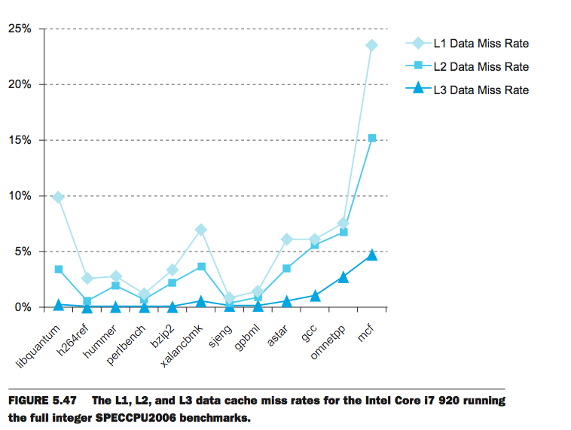
L1 Cache: 32KB I$, 32KB D$
L2 Cache: 256 KB
L3 Cache: 4 MB

Slide 33
Local vs. Global Miss Rates
Local miss rate – the fraction of references to one level of a cache that miss
Local Miss rate L2$ = $L2 Misses / L1$ Misses
Global miss rate – the fraction of references that miss in all levels of a multilevel cache
L2$ local miss rate >> than the global miss rate
Global Miss rate = L2$ Misses / Total Accesses
= (L2$ Misses / L1$ Misses) × (L1$ Misses / Total Accesses)
= Local Miss rate L2$ × Local Miss rate L1$
AMAT = Time for a hit + Miss rate × Miss penalty
AMAT = Time for a L1$ hit + (local) Miss rate L1$ × (Time for a L2$ hit + (local) Miss rate L2$ × L2$ Miss penalty)

Slide 34
Clickers/Peer Instruction
Overall, what are L2 and L3 local miss rates?
A: L2 > 50%, L3 > 50%
B: L2 ~ 50%, L3 < 50%
C: L2 ~ 50%, L3 ~ 50%
D: L2 < 50%, L3 < 50%
E: L2 > 50%, L3 ~50%

Slide 35
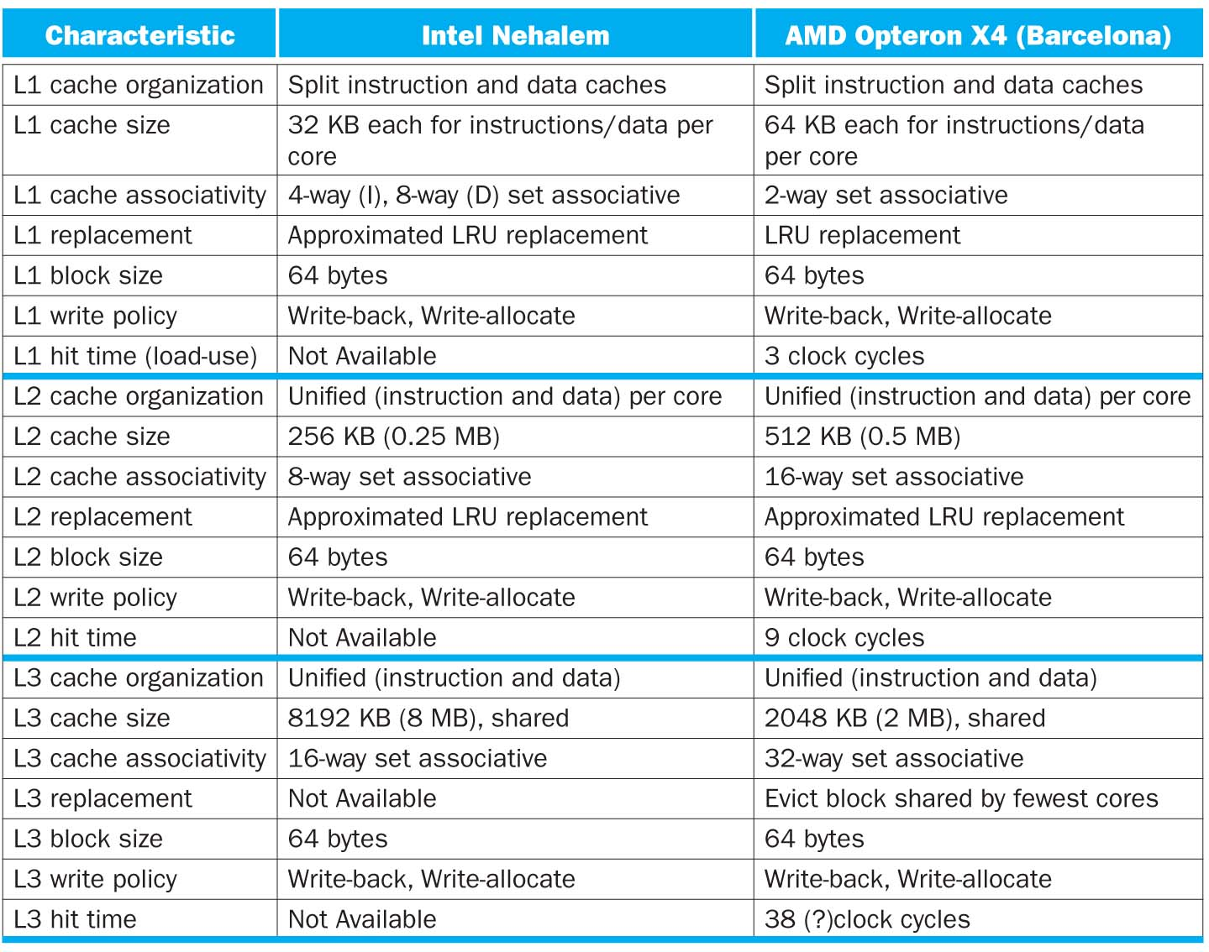

Slide 36
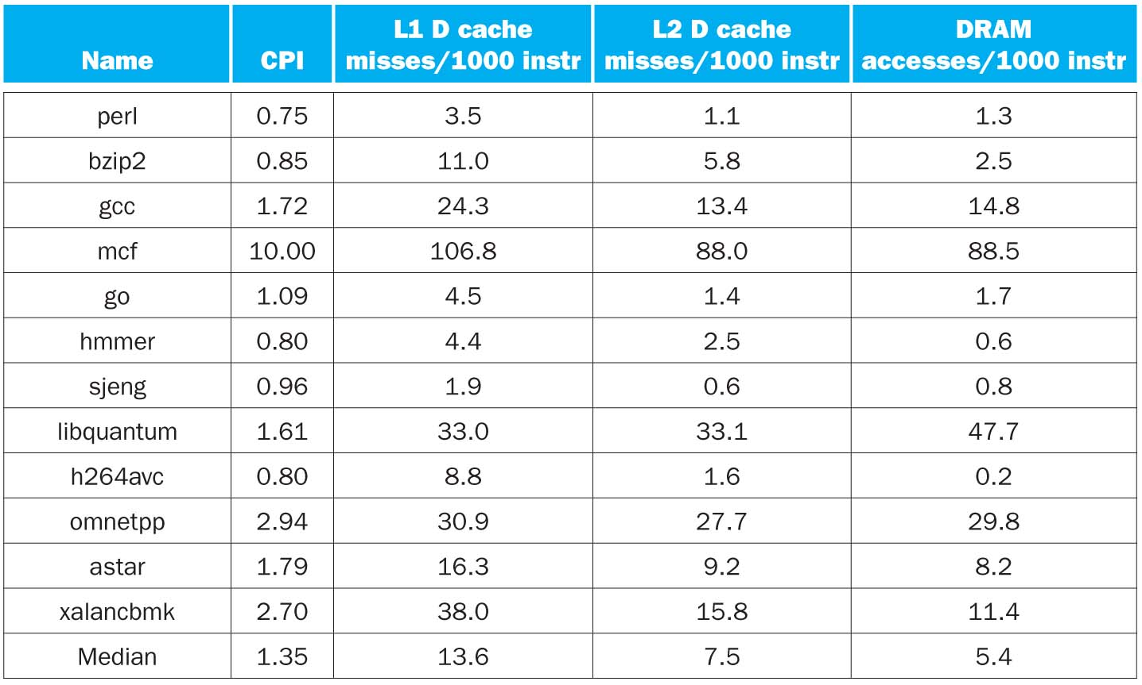
CPI/Miss Rates/DRAM Access SpecInt2006
Data Only
Data Only
Instructions and Data

Slide 37
In Conclusion, Cache Design Space
Several interacting dimensions
Cache size
Block size
Associativity
Replacement policy
Write-through vs. write-back
Write-allocation
Optimal choice is a compromise
Depends on access characteristics
Workload
Use (I-cache, D-cache)
Depends on technology / cost
Simplicity often wins
Cache Size
Associativity
Block Size
Bad
Good
Factor A
Factor B
Less
More

